Slide 1

MINI-PROJECT REVIEW I
NOTE TAKING AND TO-DO LIST APP
13-08-2025
WEDNESDAY
VIGNESHVARAN A
24PCA528

Slide 2
Introduction
The Note Taking and To-Do List App is an Android mobile application designed to help users manage their personal and professional tasks efficiently. It enables users to create, edit, and delete notes and to-do lists, offering a simple way to stay organized in one place. Developed in Android Studio using Java for logic and XML for the user interface, the app utilizes the Room Database for local, structured data storage, ensuring reliable performance even without an internet connection. With its clean design and easy navigation, the application provides a quick and effective solution for improving productivity and keeping track of daily activities anytime, anywhere..

Slide 3
System Study
Existing System
Users rely on separate tools for notes and tasks.
Paper-based methods are prone to loss/damage.
Many digital tools require internet access, have unnecessary features, or charge fees.
Existing apps are either too basic (lack search/customization) or too complex.
Need for a balanced, simple, and functional solution.

Slide 4
System Study
Proposed System
Unified Platform: Manage notes and tasks in one app.
Offline Functionality: Access and store data without internet.
Robust Data Management: Room Persistence Library with efficient CRUD operations and query validation.
User-Friendly Design: Clean, appealing UI with smooth navigation.
Customizable Notes: Change backgrounds for better categorization.
Quick Retrieval: Built-in search to find notes instantly.
Data Recovery: Undo delete option via Snackbar.

Slide 5
System Study
Problem Definition & Project Description
People struggle to manage tasks, events, and notes in today’s fast-paced lifestyle.
Traditional methods (paper or unstructured digital notes) are:
Prone to misplacement
Difficult to search
Limited in task management features

Slide 6
System Study
Problem Definition & Project Description
Many existing apps:
Are overly complex
Require constant internet access
Lack integration between notes and checklists
Need for a lightweight, offline, user-friendly app to manage both personal and professional tasks efficiently.

Slide 7
System Analysis
System Requirements
Many existing apps:
Are overly complex
Require constant internet access
Lack integration between notes and checklists
Need for a lightweight, offline, user-friendly app to manage both personal and professional tasks efficiently.

Slide 8
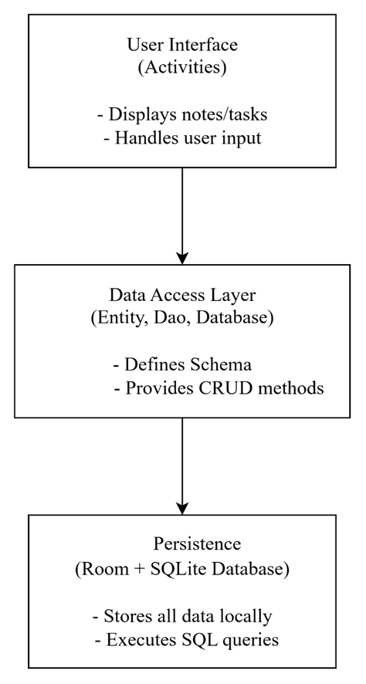
System Design
Architectural Design

Slide 9
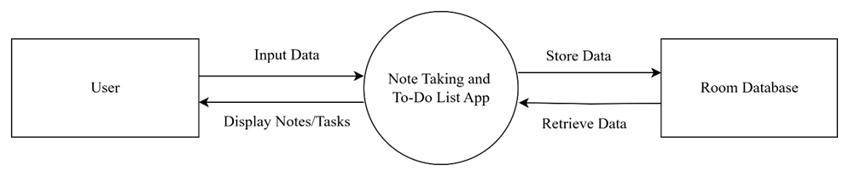
System Design
Data Flow Diagram
DFD Level 0

Slide 10
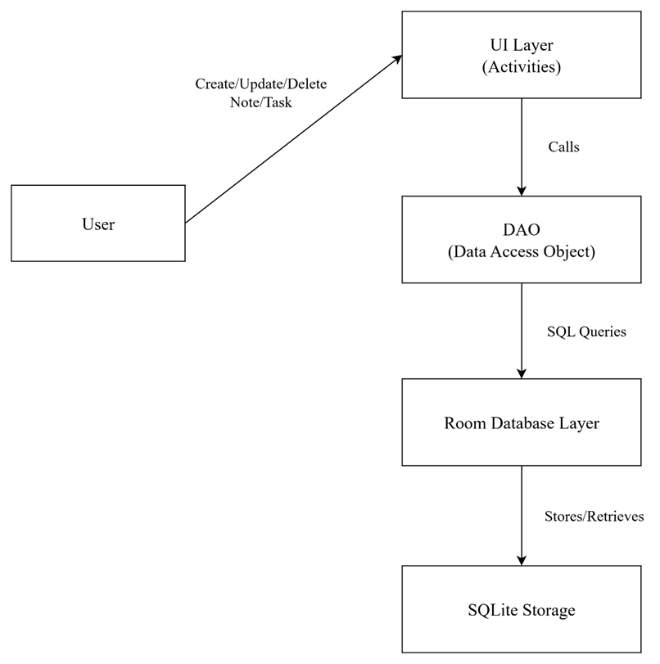
System Design
Data Flow Diagram
DFD Level 1

Slide 11
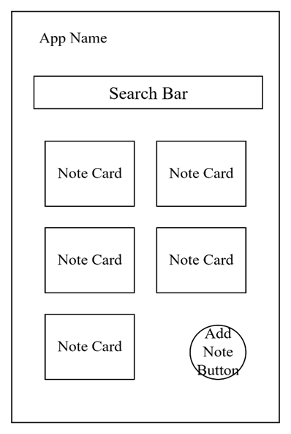
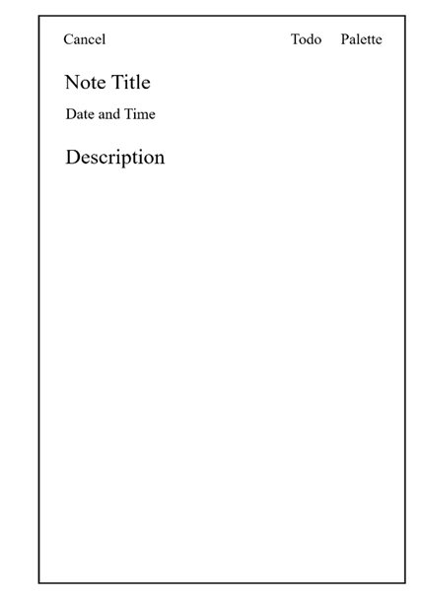
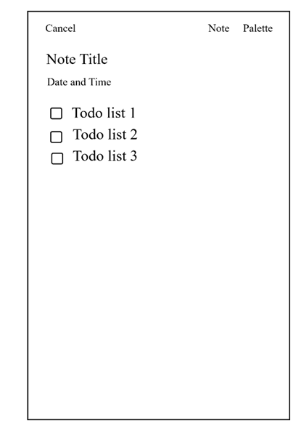
User Interface Design
Home Page
Note Creation Page
Todo List Mode

Slide 12
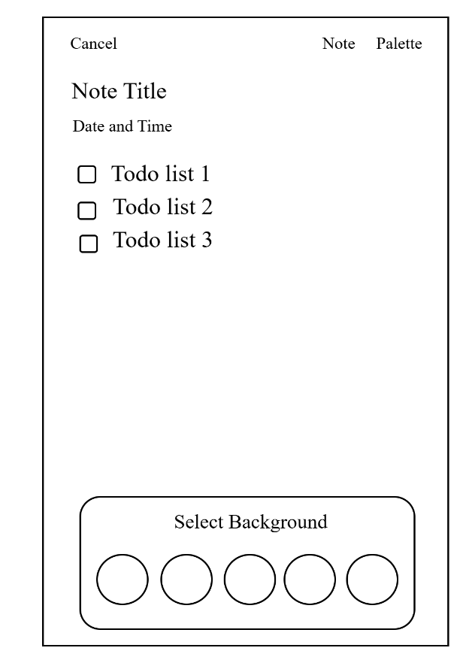
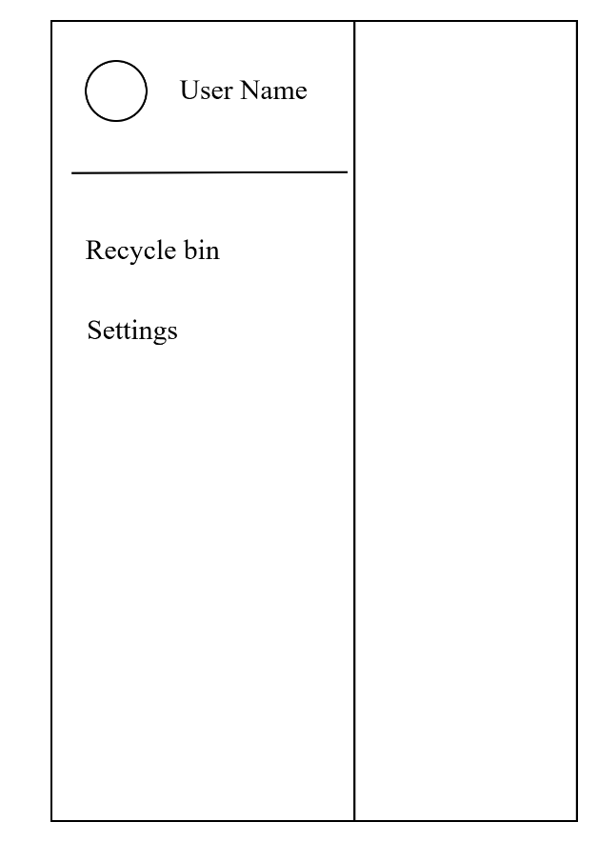
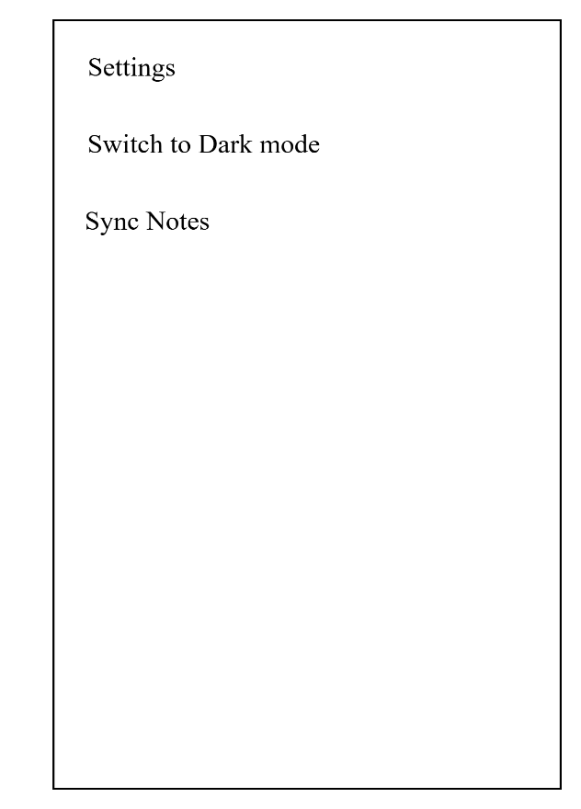
User Interface Design
Choose Color
Side Bar
Settings

Slide 13
Normalization
Normalization is the process of organizing the data in the database.
Normalization is used to minimize the redundancy from a relation or set of relations.

Slide 14
THANK YOU

